Slide 1
Jhansi Muppalla
Nitya Sai Mounisha Korada Jyotheeswar Mandala Venkata Surya Mouli Sree Vamsi Mallady Group No: 19
INFO 5082

Slide 2
AI Multilingual Chatbot for Lung Cancer Detection
A multilingual AI chatbot that detects lung cancer from CT scans using Swin Transformer model. It generates a patient-friendly medical report and answers health-related questions in the user’s native language using NLLB and BioBERT

Slide 3
Agenda
Title
Motivation
Background
Abstract(Problem statement)
Literature Survey
Objectives of the Study
Data Set and Data Processing
Research Design(Blueprint/Workflow)
Data Analysis and Model Description
Results and Visualizations
Conclusion
References

Slide 4
Motivation
Lung cancer is the leading cause of cancer-related deaths, with many cases detected too late.
Early diagnosis significantly improves survival, but manual CT scan analysis is slow and subjective.
There’s a growing demand for AI-powered tools to assist in fast and reliable lung cancer detection.
Many existing systems are not user-friendly or multilingual, limiting accessibility for patients worldwide.

Slide 5
Background
LIDC-IDRI Dataset: A public dataset of over 1000 lung CT scans annotated by radiologists, widely used for research in lung cancer.
Malignancy Scoring: Radiologists assign malignancy scores (1-5) based on the likelihood of a nodule being cancerous.
Swin Transformer: A powerful vision transformer model designed for image-based tasks, offering better performance on medical image analysis.
BioBERT & NLLB: BioBERT helps in answering medical questions, while NLLB enables translation to 100+ languages for wider accessibility.

Slide 6
Problem Statement
Lung cancer is one of the leading causes of cancer-related deaths worldwide.
Early diagnosis significantly improves survival rates but is often delayed due to limited access to radiologists and specialists.
CT scan interpretation requires expert analysis, which is not always available, especially in rural or low-resource settings.
Patients find it difficult to understand medical reports due to technical language and lack of native language support.
There is a lack of AI Systems that combine accurate diagnosis with multilingual, patient-friendly explanations.

Slide 7
Literature Review
Ardila et al. (2019) developed a 3D deep learning model using low-dose CT scan for accurate lung cancer screening. Their work set a benchmark in automated diagnosis, emphasizing end-to-end learning from imaging.
Li et al. (2022) introduced BLIP, enabling textual generations from images.
Meta’s NLLB is a state-of-the-art-multilingual translation system that supports communication in 200+ languages for patient understanding.
Our project enhances prior models by using Swin Transformer which provides superior feature extraction and better performance on CT images.
Existing tools focus only on diagnosis but lack patient-friendly multilingual explanation. Our work bridges this gap by combining detection + explanation + translation.

Slide 8
Objectives of the Study
Primary Objective:
To develop an AI-Powered system that detects lung cancer from CT scans by predicting malignancy scores and delivering multilingual, patient-friendly medical reports through an interactive chatbot interface.
Specific Objectives:
Preprocess and structure CT scan data from the LIDC-IDCRI dataset → Enable clean input for accurate model training.
Train swin transformer model to predict malignancy scores → Improve early detection using deep learning.
Integrate Meta’s NLLB model to translate medical reports.
Incorporate BioBERT for question answering in a medical context.
Build an interactive chatbot interface for report generation and follow up

Slide 9
Dataset Collection
Source: LIDC-IDRI (Lung Image Database consortium and Image Database Resource Initiative)
Contents:
Over 1000 CT scans studies
Includes DICOM files and XML annotations from multiple radiologists.
Annotations include:
Lung nodules >= 3mm
Radiologist malignancy ratings (1-5) per nodule.
Subset used:
First 100 patient cases for faster experimentation and development.
Additional File:
Used a precompiled Excel sheet mapping patient IDs to nodule counts

Slide 10
Dataset Preprocessing
Image Conversion
DICOM → PNG using pydicom & opencv
Applied histogram equalization to enhance contrast
Malignancy Score Extraction
Parsed XML annotations using Element Tree
Extracted and averaged malignancy scores from radiologists
Dataset Structuring
Mapped images with corresponding average malignancy scores
Created final CSV with image paths and labels
Dataset Splitting
Train/Validation/Test split: 70%/15%/15%
Saved into separate CSV files
Image Transformation
Resized into 224*224
Normalized using ImageNet statistics for swin transformer input

Slide 11
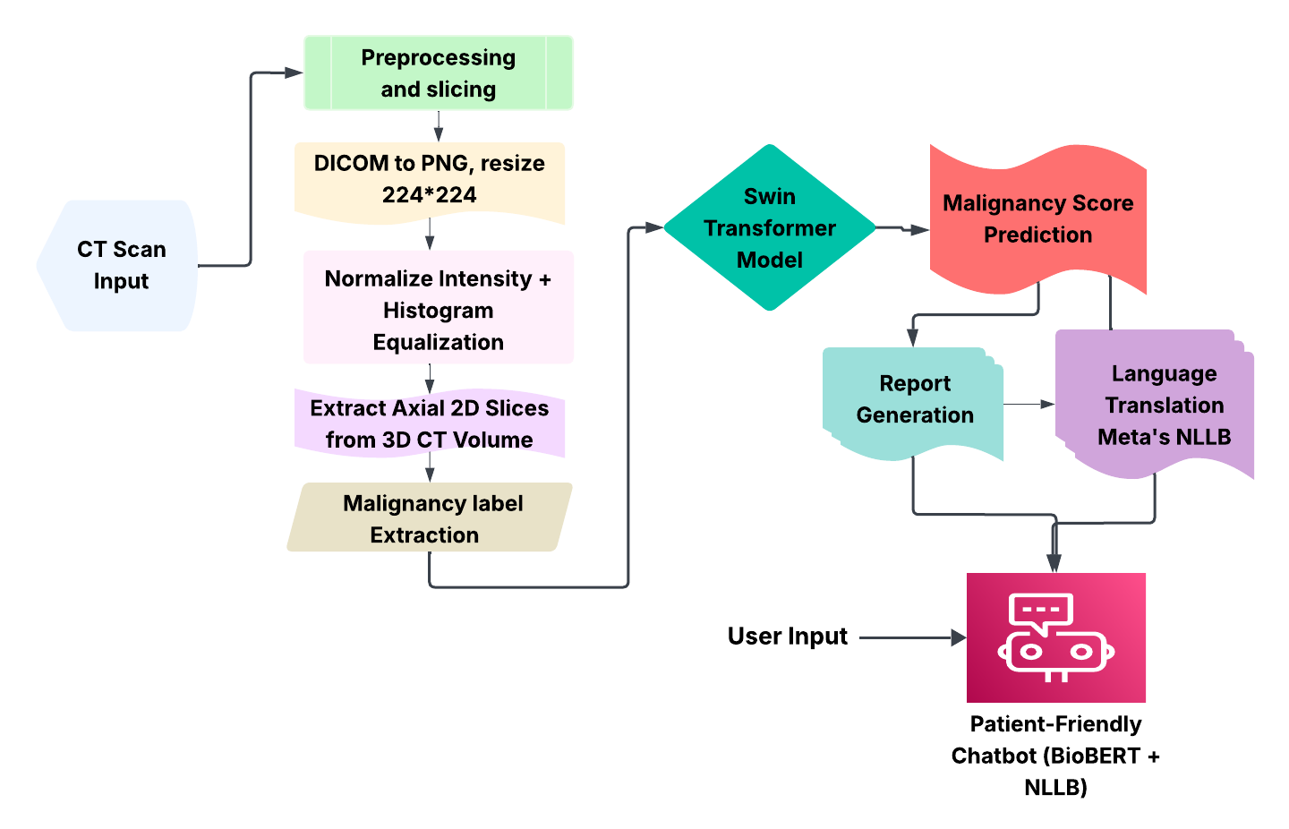
Research Design

Slide 12
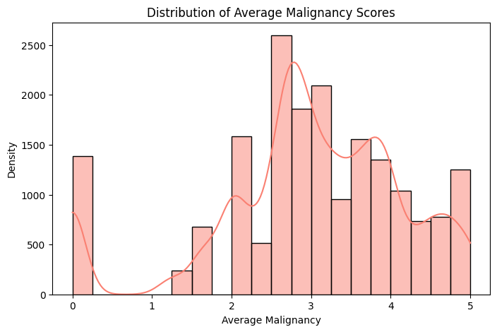
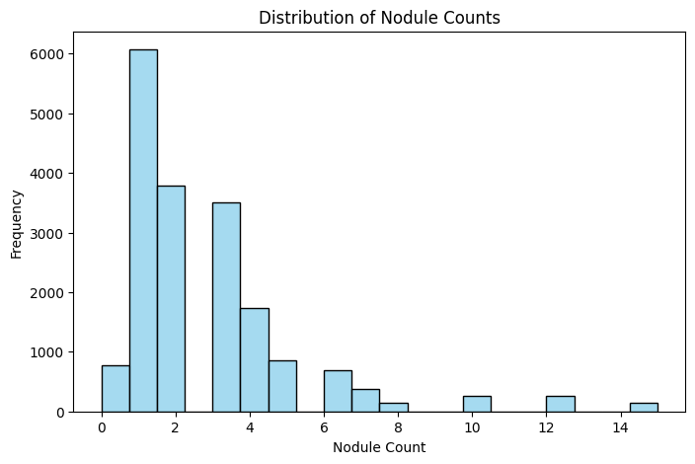
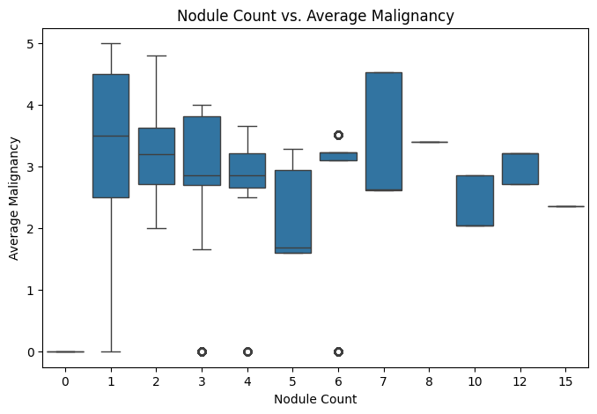
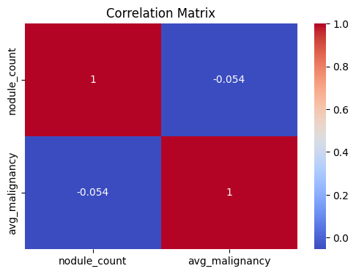
Exploratory Data Analysis

Slide 13
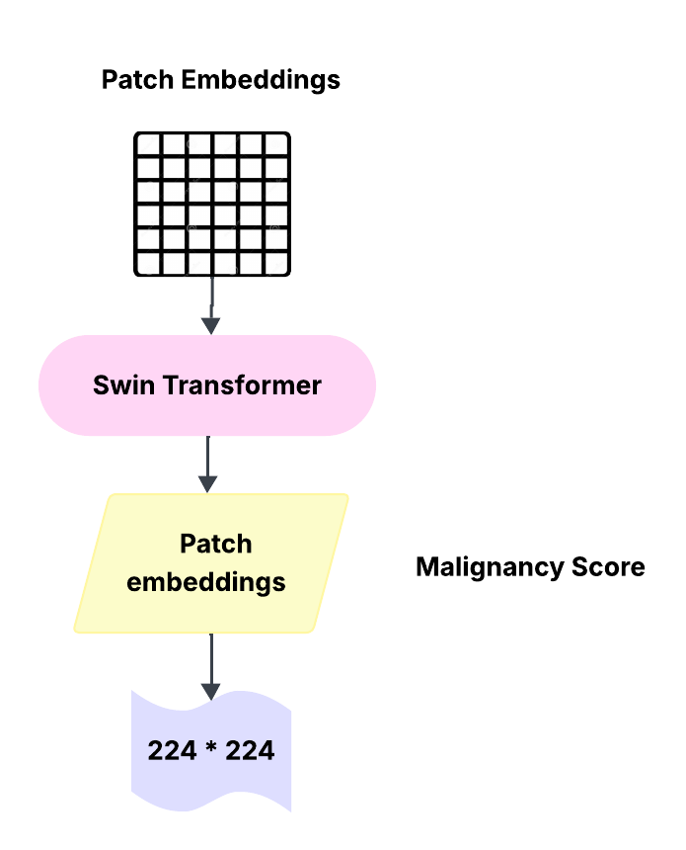
Model Description: Swin Transformer
Swin Transformer is a powerful vision transformer architecture designed for efficient and scalable image analysis.
Why Swin Transformer?
Captures both local and global image features
Ideal for analyzing complex CT scan patterns
Outperforms traditional CNNs in medical image regression tasks
Our Implementation:
Input size: 224 * 224 axial CT slices (preprocessed)
Output: continuous malignancy scores (regression)
Loss function: Mean Squared Error (MSE)
Optimizer: AdamW with learning rate scheduling
Pretrained Weights: Initialized with ImageNet-pretrained backbone for transfer learning.

Slide 14
Model Training & Evaluation
Used Swin transformer (Tiny variant) – fine-tuned for regression to predict malignancy score from lung CT scan images.
Dataset Split:
100 patients' data from LIDC-IDRI
70% training | 15% validation | 15% testing
Loss Function & Optimizer:
Loss: Mean Squared Error(MSE)
Optimizer: Adam (Learning rate = 1e-4)
Training Parameters : 10 Epochs, 32 batch size,
224*224 input image size.
Evaluation Metrics:
Mean Squared Error (MSE)
Mean Absolute Error (MAE)
R² Score

Slide 15
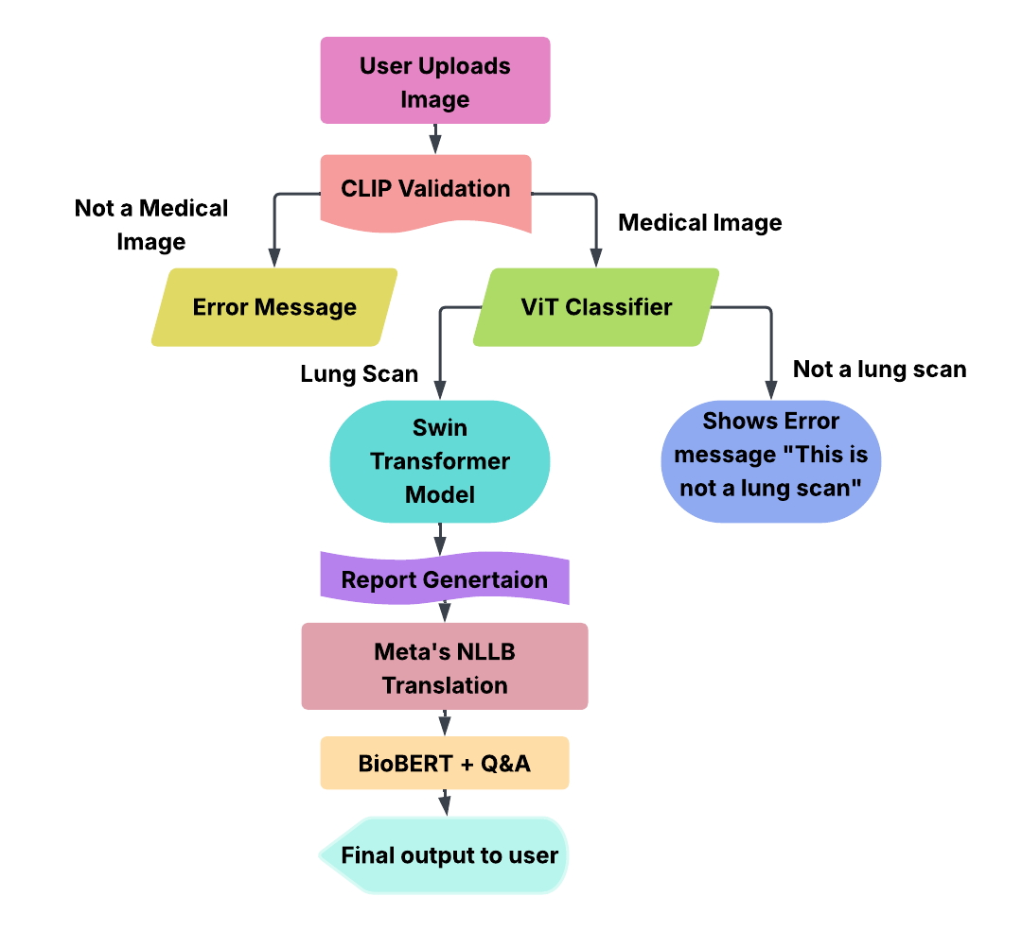
Chatbot Interface
CLIP + ViT Validation Makes sure only real time CT scans
are accepted.
Swin Transformer Predicts malignancy scores
from valid CT scans
Medical Reports are generated automatically based on
AI analysis
Meta’s NLLB provides multilingual support for 50+ languages
BioBERT Q&A lets users ask health-related questions in
plain language.
Doctor direction is offered for real consultations

Slide 16
Chatbot Interface
Auto-Generated Medical Reports
Based on Swin Transformer predictions, the chatbot generates easy-to-understand reports from CT scan images.
Multilingual Support using Meta’s NLLB
Patients select their native language (like Telugu, Hindi, Tamil, etc.) and get reports as well as chatbot responses translated in real-time.
Patient-Friendly Q&A
Using BioBERT, users can ask questions like “what is a malignancy score?” or “What is a lung cancer?” like that and get a clear, AI-powered answers.
We also included redirection setting page where user can navigate to that page to schedule an appointment with a doctor.

Slide 17
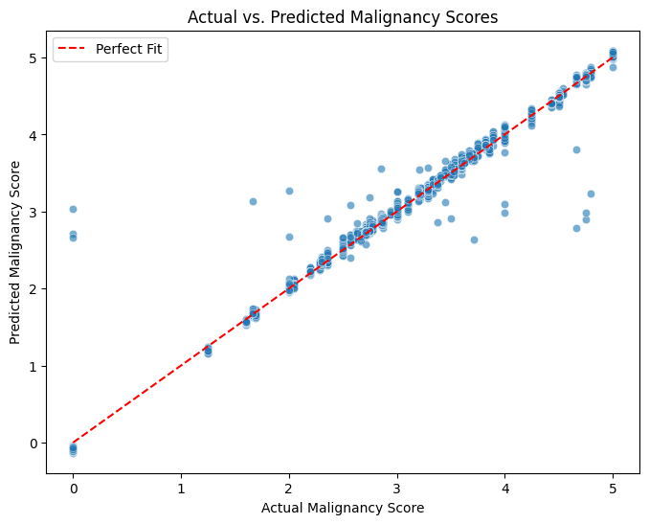
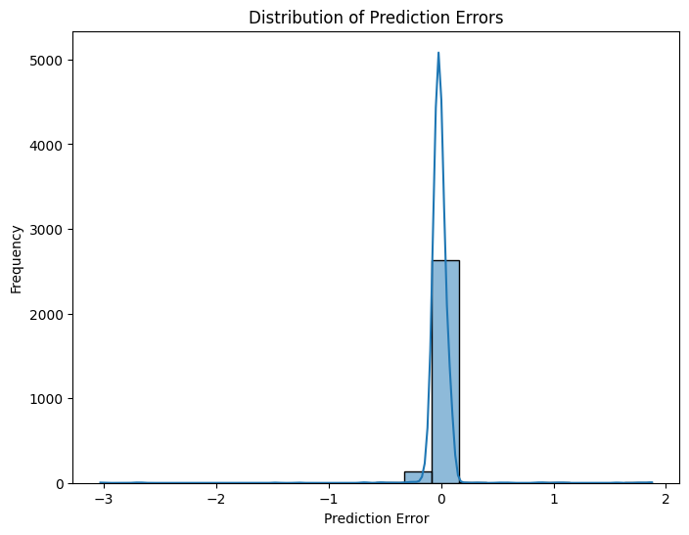
Model Results & Visualization
Evaluation Metrics:
Mean Squared Error (MSE): 0.0192
Mean Absolute Error (MAE): 0.0500
R² Score: 0.9872

Slide 18
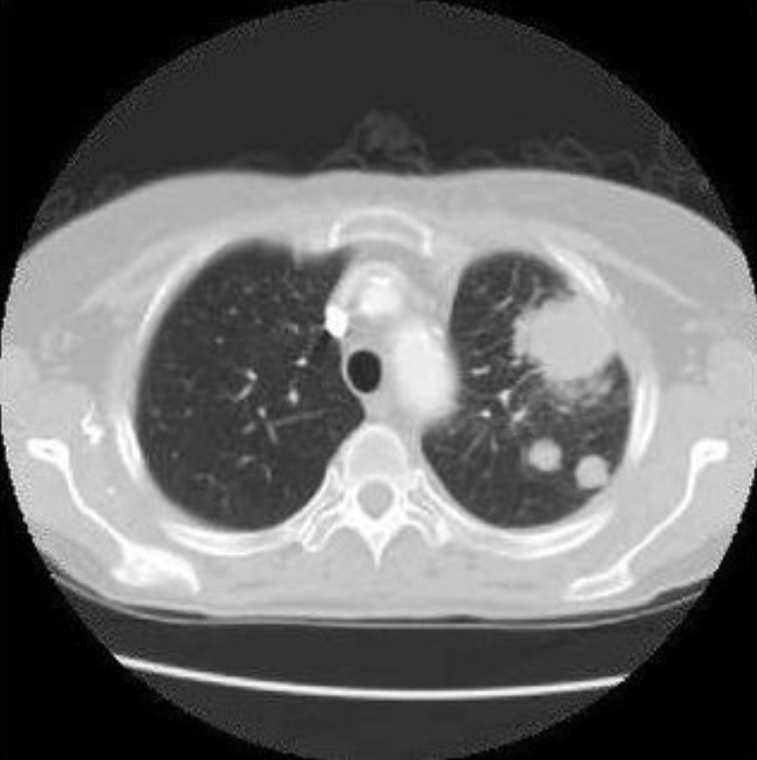
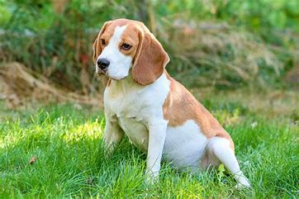
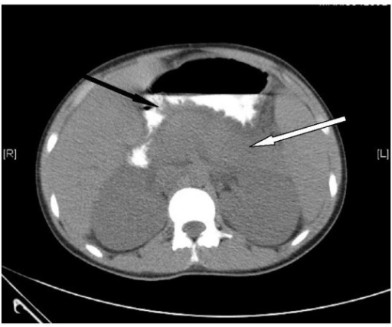

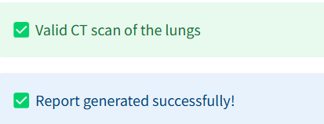


Chatbot Results
Image Type | CLIP Output | ViT Output
Lung CT Scan | Medical | Lung
Dog Image | No | Reject
Abdomen/other CT scans | Medical | Not Lung
Chart/Diagrams | Not Medical | Reject
Chatbot accurately filters non-lung or non-medical images before running analysis.
Validation Accuracy (CLIP + ViT)

Slide 19
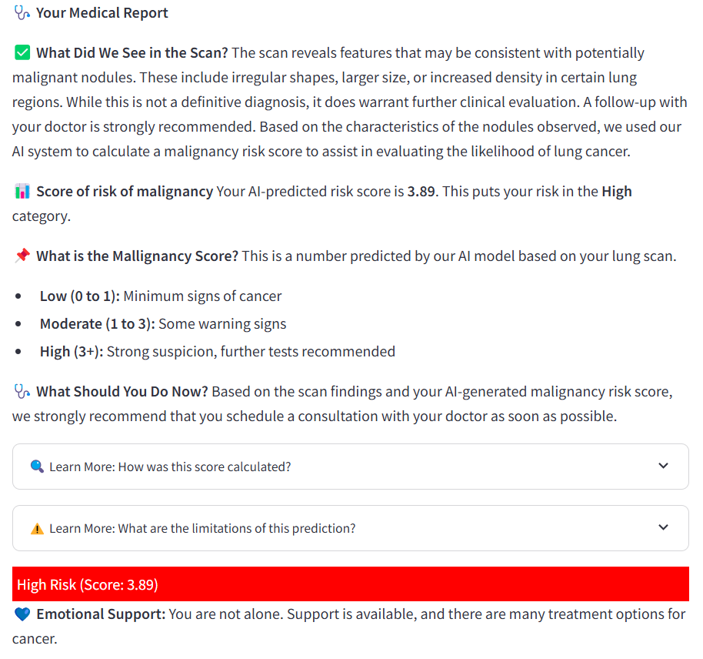
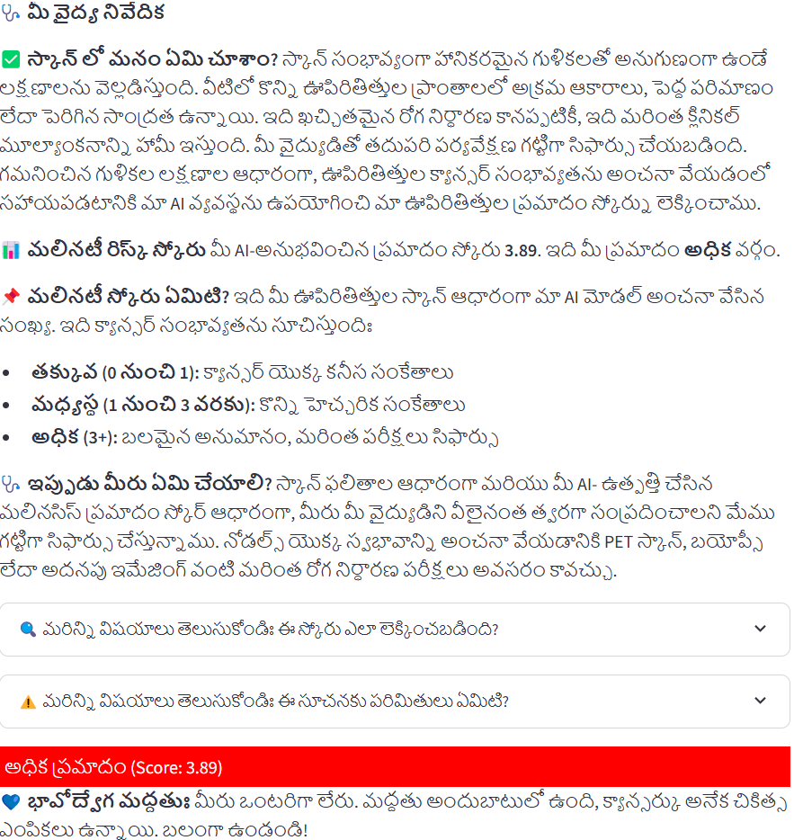
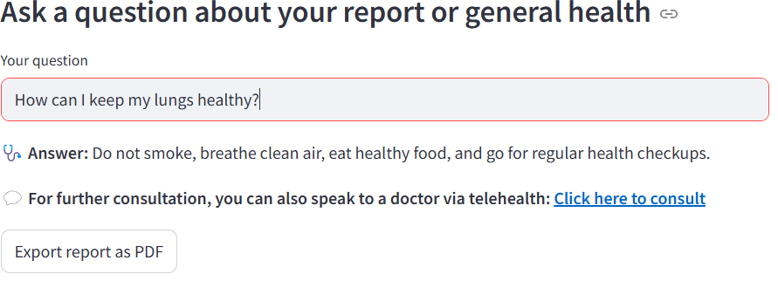
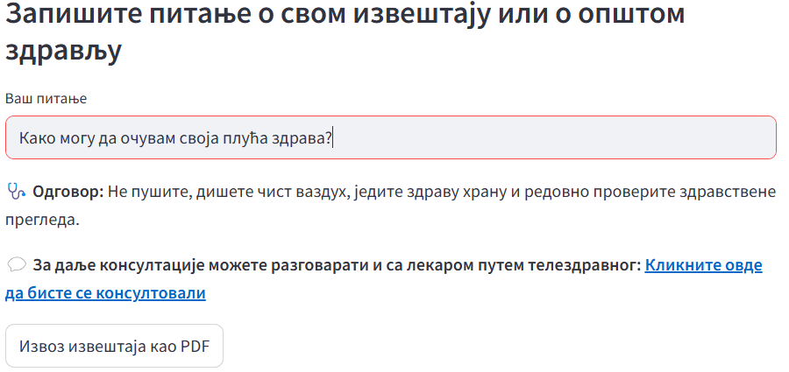
Chatbot Results
Multilingual Report Generation
Users receive reports in their selected language using Meta’s NLLB model (50+ supported)
Q&A Results (BioBERT)
Medical questions answered using BioBERT model (auto-detected and translated

Slide 20
Conclusion
We successfully built a multilingual AI chatbot for early detection of lung cancer from CT scans. Integrated Swin Transformer for malignancy score prediction using LIDC-IDRI dataset. We also used CLIP and ViT models to validate that only real lung CT scans are accepted.
Reports and responses are delivered in 50+ languages using Meta’s NLLB translation model. Patients can interact with the chatbot and receive clear, patient-friendly answers powered by BioBERT

Slide 21
References
Ardila, D., Kiraly, A. P., Bharadwaj, S., Choi, B., Reicher, J. J., Peng, L., ... & Shetty, S. (2019). End-to-end lung cancer screening with three-dimensional deep learning on low-dose chest computed tomography. Nature Medicine, 25(6), 954–961.
Lee, J., Yoon, W., Kim, S., Kim, D., Kim, S., So, C. H., & Kang, J. (2019). BioBERT: A pre-trained biomedical language representation model for biomedical text mining. Bioinformatics, 36(4), 1234–1240.
Meta AI. (2022). No Language Left Behind: Scaling human-centered machine translation. Retrieved from https://ai.facebook.com/research/no-language-left-behind
Li, J., Kim, D., & Baldridge, J. (2022). BLIP: Bootstrapped Language-Image Pretraining. arXiv preprint, arXiv:2201.12086.
The Cancer Imaging Archive. (n.d.). LIDC-IDRI: Lung Image Database Consortium and Image Database Resource Initiative. Retrieved from https://www.cancerimagingarchive.net
Dosovitskiy, A., Beyer, L., Kolesnikov, A., Weissenborn, D., Zhai, X., Unterthiner, T., ... & Houlsby, N. (2020). An image is worth 16x16 words: Transformers for image recognition at scale. arXiv preprint, arXiv:2010.11929

Slide 22
Thank You

